Slide 1
Lambda Expressions
Modern Topics in IT(MTIT)
4th Year – Semester 1
By Udara Samaratunge

Slide 2

Java 8 Lambda Expressions
Introduction
Anonymous classes
Syntax of Java 8 lambda expressions
Functional interfaces
Default methods
Method references
Benefits of Lambda Expression

Slide 3
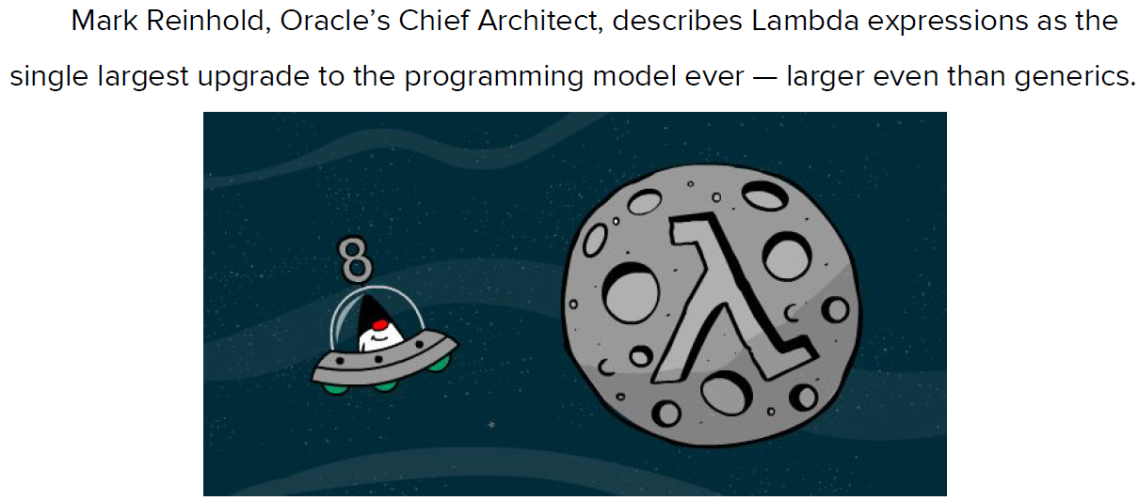
Introduce Lambda Expressions

Slide 4
Why Java need Lambda?
One issue with anonymous classes is that if the implementation of your anonymous class is very simple, such as an interface that contains only one method, then the syntax of anonymous classes may seem unwieldy and unclear.
In these cases, you're usually trying to pass functionality as an argument to another method, such as what action should be taken when someone clicks a button.
Lambda expressions enable you to do this, to treat functionality as method argument, or code as data.

Slide 5
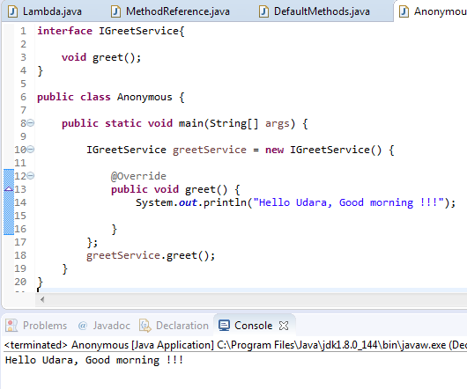
Anonymous Classes
Enable you to declare and instantiate a class at the same time.
They are like local classes except that they do not have a name.
Use them if you need to use a local class only once.

Slide 6
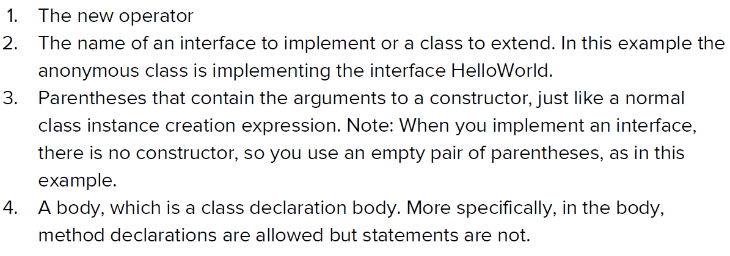
Anonymous Class

Slide 7
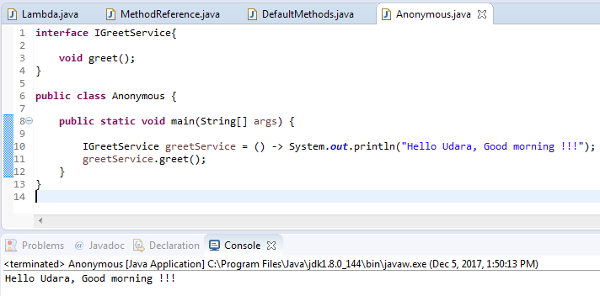
Anonymous Class

Slide 8
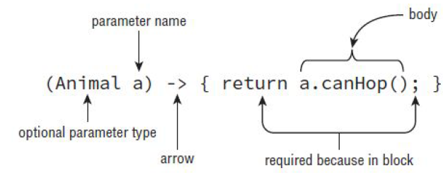
Simple Lambda Expression Syntax - Complete

Slide 9
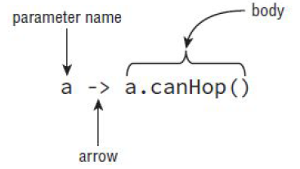
Simple Lambda Expression Syntax - Simplified
Simplifying Rules
The parenthesis can only be omitted if there is a single parameter and its type is not explicitly stated
Can omit braces when there is only one statement in the body
Does not require to type return or semicolon when braces are omitted

Slide 10
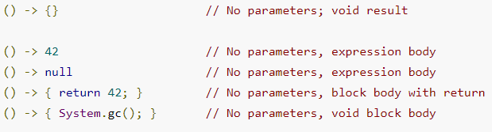
Lambda Syntaxes

Slide 11
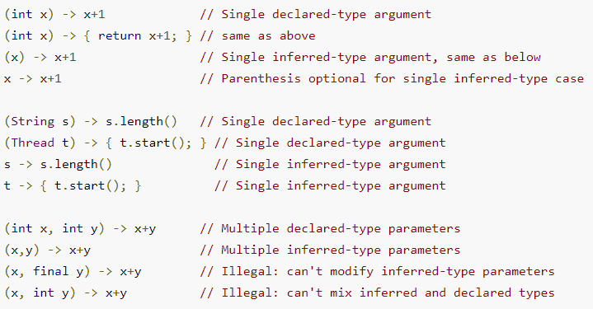
Lambda Syntax

Slide 12
Examples of Lambda Syntax
(int x, int y) -> { return x + y; }
//Returns the sum of two integers
(x, y) -> x + y
/*
* Returns the sum of two numbers types of parameters and return type
* are inferred body is a single expression; braces omitted
*/
n -> n % 2 == 0
//returns true if n is even (type is inferred)
() -> 42
/*
* Constant function, no parameters returns the answer to the ultimate
* question of life, the universe, and everything
*/

Slide 13
More Examples of Java 8 Lambdas
A Java 8 lambda is basically a method in Java without a declaration usually written as (parameters) -> { body }. Examples,
(int x, int y) -> { return x + y; }
x -> x * x
( ) -> x
A lambda can have zero or more parameters separated by commas and their type can be explicitly declared or inferred from the context.
Parenthesis are not needed around a single parameter.
( ) is used to denote zero parameters.
The body can contain zero or more statements.
Braces are not needed around a single-statement body.

Slide 14
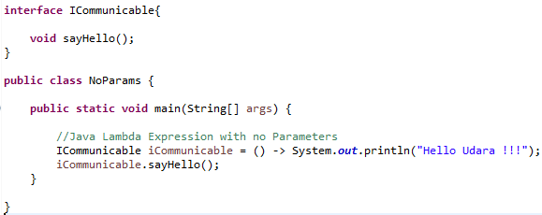

Java Lambda Expression with no Parameters

Slide 15
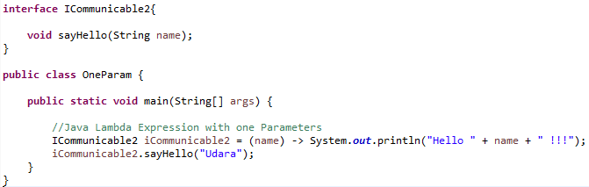

Java Lambda Expression with one Parameter

Slide 16
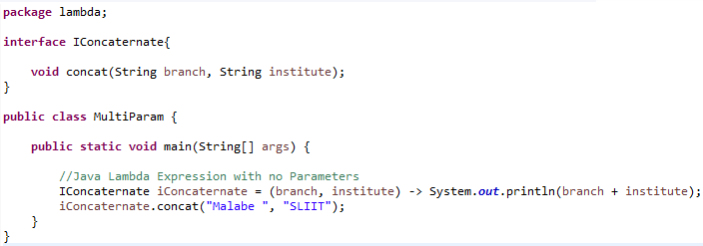

Java Lambda Expression with multiple Parameters

Slide 17
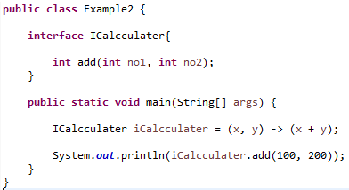

Lambda Syntax
Response

Slide 18
Lambda Syntax
Optional type declaration − No need to declare the type of a parameter. The compiler can inference the same from the value of the parameter.
Optional parenthesis around parameter − No need to declare a single parameter in parenthesis. For multiple parameters, parentheses are required.
Optional curly braces − No need to use curly braces in expression body if the body contains a single statement.
Optional return keyword − The compiler automatically returns the value if the body has a single expression to return the value. Curly braces are required to indicate that expression returns a value.

Slide 19
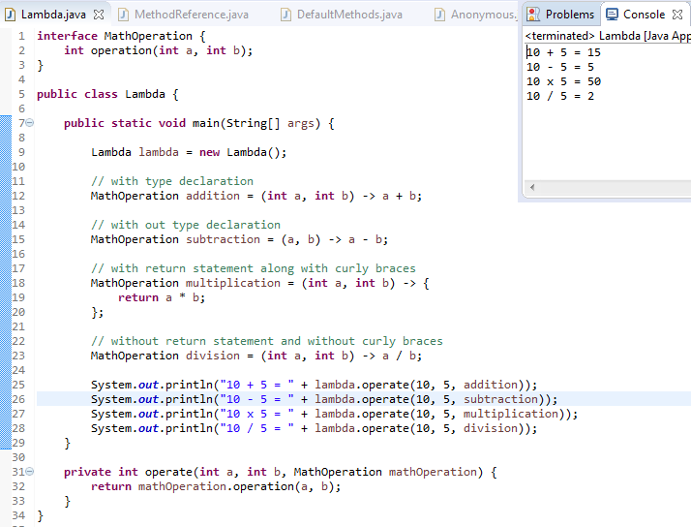
Lambda Syntax

Slide 20
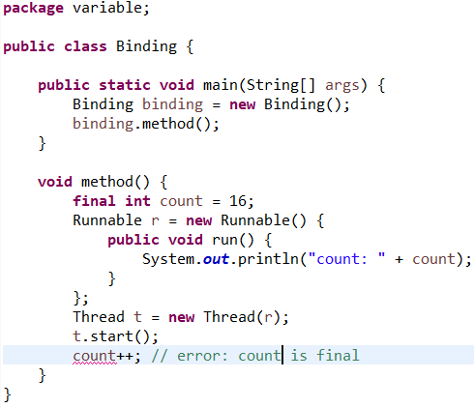
Lambda Variable Binding
Without using Lambda Expressions
Final variable can not be reassigned
cont++ implies count = count + 1
Compile Error

Slide 21
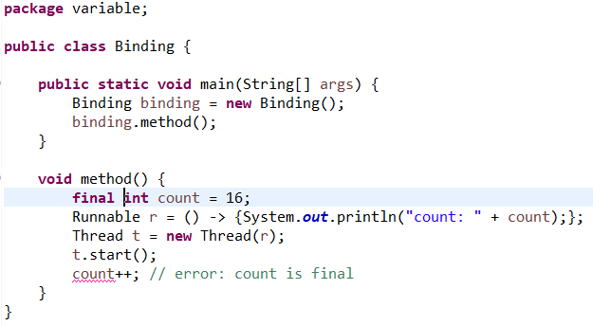
Lambda Variable Binding
Using Lambda Expressions
Final variable can not be reassigned
cont++ implies count = count + 1
Still Compile Error
What happens if you remove final keyword?

Slide 22

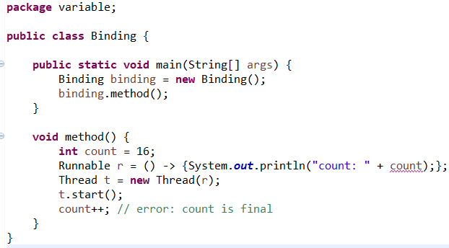
Lambda Variable Binding
Using Lambda Expressions
No final keyword for the variable declarations
Still Compile Error
The difference is that the count variable need not be declared as final in the enclosing context.
The compiler automatically treats it as final as soon as it is used inside a lambda expression
In other words, variables from the enclosing context that are used inside a lambda expression are implicitly final (or effectively final).

Slide 23
Functional Interfaces

Slide 24
Functional Interfaces
Is an interface
Functional Interfaces can only be used with Lambda Expressions
Must have only one abstract method
In JDK 7 this would mean only one method (like ActionListener)
JDK 8 introduced default methods
Adding multiple inheritance of types to Java These are, by definition, not abstract
Functional Interface can have only one abstract methods but 0 or more default methods or static methods
@FunctionalInterface to have the compiler check

Slide 25
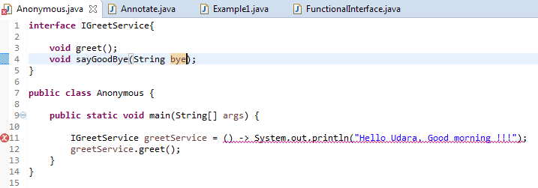

Is This A Functional Interface?
Functional Interface should have only one abstract method

Slide 26
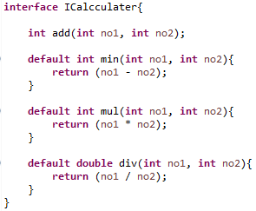


Is This A Functional Interface?
But you can include multiple default methods

Slide 27
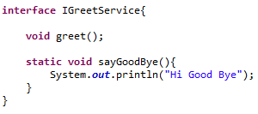

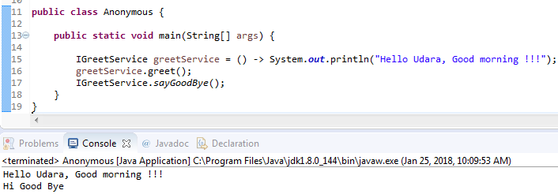
Is This A Functional Interface?
You can include multiple default or static methods

Slide 28

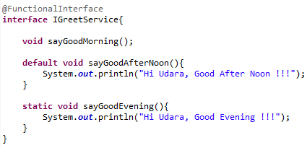

Functional Interface
@FunctionalInterface annotation is useful for compilation time checking of your code
But you can use lambdas without this annotation as well as you can override methods without @Override annotation

Slide 29
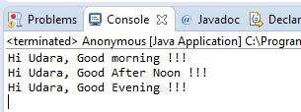
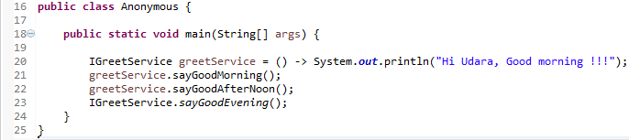
Functional Interface
Access static method

Slide 30
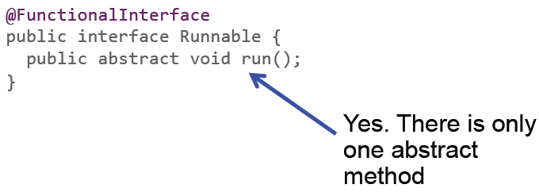
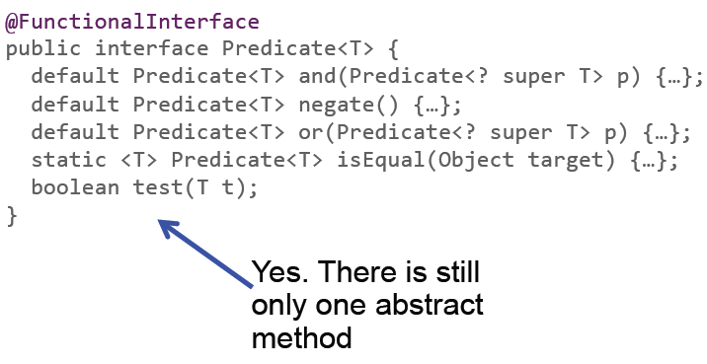
Is This A Functional Interface?

Slide 31
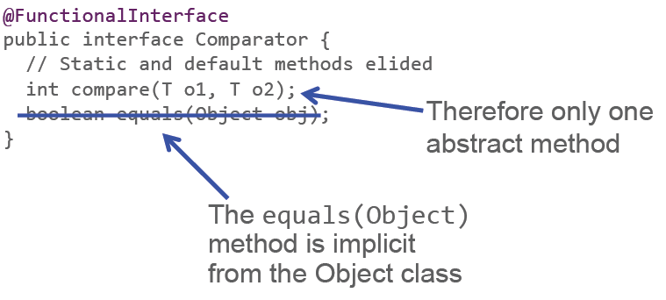
Is This A Functional Interface?

Slide 32
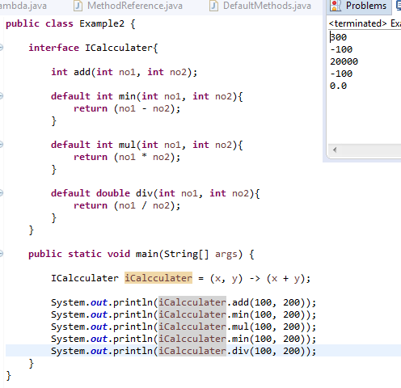
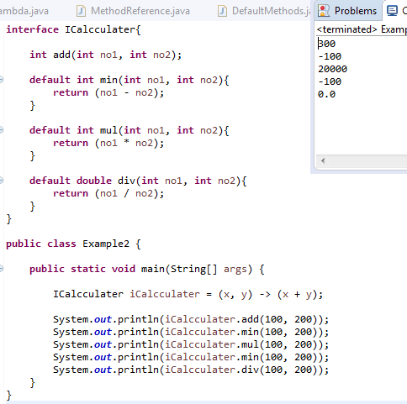
Lambda Expressions with Functional Interface
Interface within the class
Interface outside the class

Slide 33
Method References

Slide 34
Method References
What is the Method References?
Method reference is the shorthand notation of a lambda expression to call a method
If your lambda expression is like this:
then you can replace it with a method reference like this:
The :: operator is used in method reference to separate the class or object from the method name
str -> System.out.println(str)
System.out::println

Slide 35
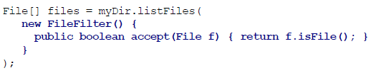

What is the difference ?
Anonymous Inner classes
Lambda Expressions
Method References

Slide 36
Method References
Four Types of Method References
Method reference to an instance method of an object – object::instanceMethod
Method reference to a static method of a class – Class::staticMethod
Method reference to an instance method of an arbitrary object of a particular type – Class::instanceMethod
Method reference to a constructor – Class::new

Slide 37
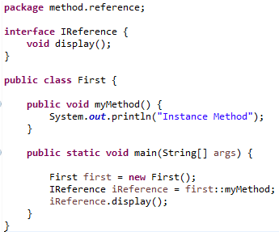

1. Method Reference to an instance method of an object

Slide 38


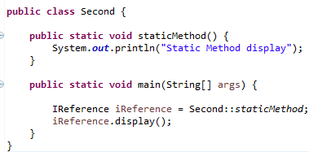
2. Method Reference to an instance method of an object
Static method reference

Slide 39
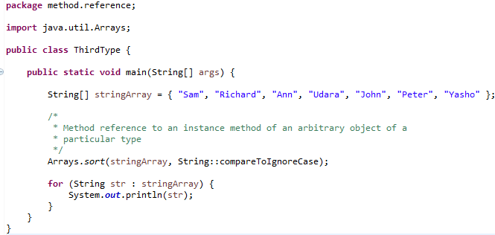
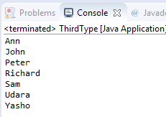
3. Method reference to an instance method of an arbitrary object of a particular type

Slide 40
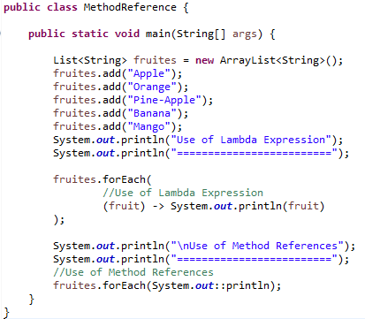
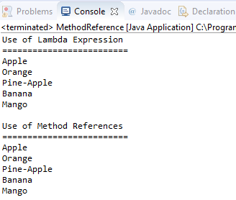
3. Method reference with and without examples

Slide 41
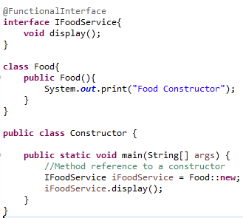

4. Method Reference to a Constructor
Use new key word with :: operator to invoke constructor of the class

Slide 42
Summary of Method References
Method Reference Type | Syntax | Example
static | ClassName::StaticMethodName | String::valueOf
constructor | ClassName::new | ArrayList::new
specific object instance | objectReference::MethodName | x::toString
arbitrary object of a given type | ClassName::InstanceMethodName | Object::toString

Slide 43
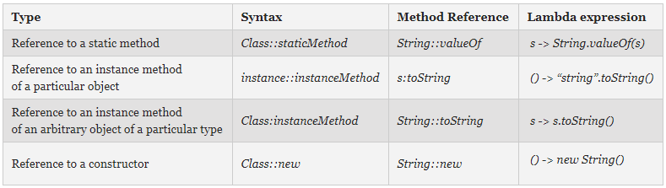
Summary of Method References & Lambda Expressions

Slide 44

Multiple Inheritance of Ambiguities
interface ITestable1{
public default void readAnnotations(){
System.out.println("Read Annotations 01");
}
}
interface ITestable2{
public default void readAnnotations(){
System.out.println("Read Annotations 02");
}
}
public class Annotate implements ITestable1, ITestable2{
public static void main(String[] args) {
Annotate diff = new Annotate();
diff.readAnnotations();
}
}

Slide 45
Solution for Multiple Inheritance
interface ITestable1{
public default void readAnnotations(){
System.out.println("Read Annotations 01");
}
}
interface ITestable2{
public default void readAnnotations(){
System.out.println("Read Annotations 02");
}
}
public class Annotate implements ITestable1, ITestable2{
public static void main(String[] args) {
Annotate diff = new Annotate();
diff.readAnnotations();
}
@Override
public void readAnnotations() {
ITestable1.super.readAnnotations();
ITestable2.super.readAnnotations();
}
}

Slide 46
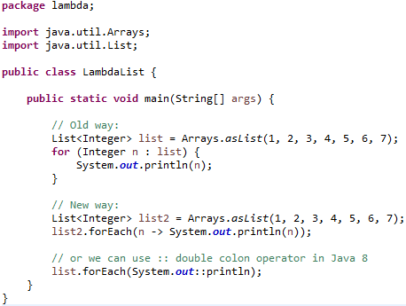
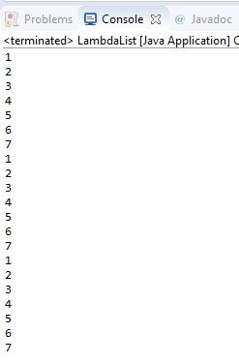
Apply Lambda Expressions – List iteration

Slide 47
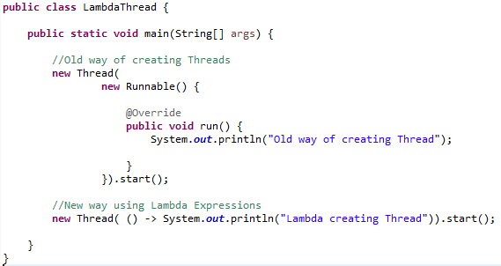

Apply Lambda Expressions for Threads

Slide 48
Benefits of Lambdas in Java 8
Enabling functional programming
Writing leaner more compact code
Facilitating parallel programming
Developing more generic, flexible and reusable APIs
Being able to pass behaviors as well as data to functions

Slide 49
References
The Java Tutorials, http://docs.oracle.com/javase/tutorial/java/index.html
Lambda Expressions, http://docs.oracle.com/javase/tutorial/java/javaOO/lambdaexpressions.html
Adib Saikali, Java 8 Lambda Expressions and Streams, www.youtube.com/watch?v=8pDm_kH4YKY
Brian Goetz, Lambdas in Java: A peek under the hood. https://www.youtube.com/watch?v=MLksirK9nnE

Slide 50

The End

